Slide 1
EXPANDED USE CASES
By – Kanaga Manikandan Solaikannan

Slide 2
What are expanded use cases?
Expanded Use Case is a detailed description of the processes used to complete various system functions.
We’ll be covering on how expanded use cases were used to identify requirements and organise the management of the software development exercise.
We’ll also be covering on how it provided more knowledge than that of an existing use case diagram.

Slide 3

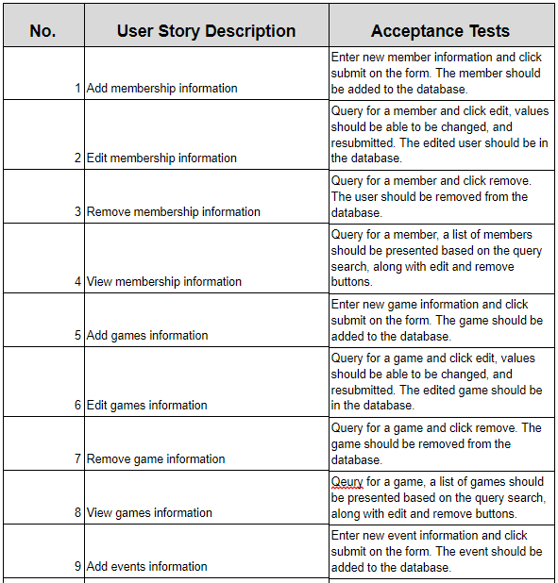
How did it help identify requirements?
The functions and processes of the system software were derived from the user stories of this project.
From these functions, the team was able to categorise each function into primary and secondary functions.
Primary functions are those which are very essential to the software product. Secondary functions are those which will help the user to perform extra features.
Notes:
3rd point – The software will still work even without the secondary functions.

Slide 4
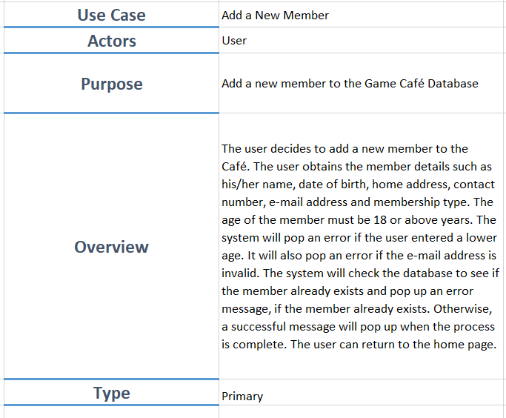
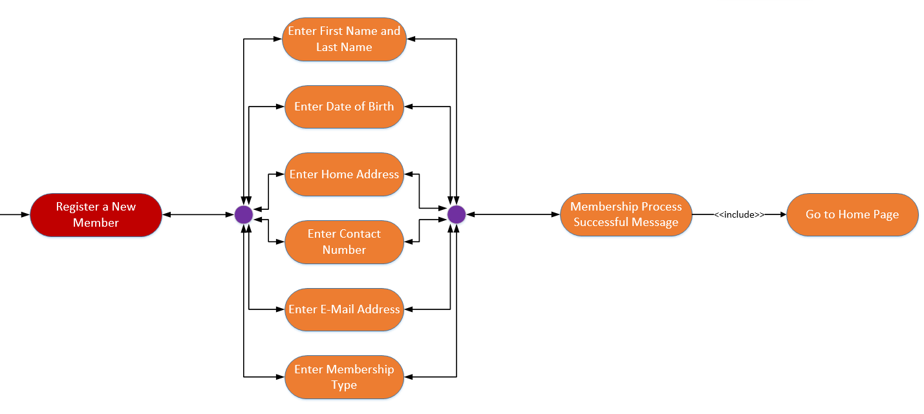
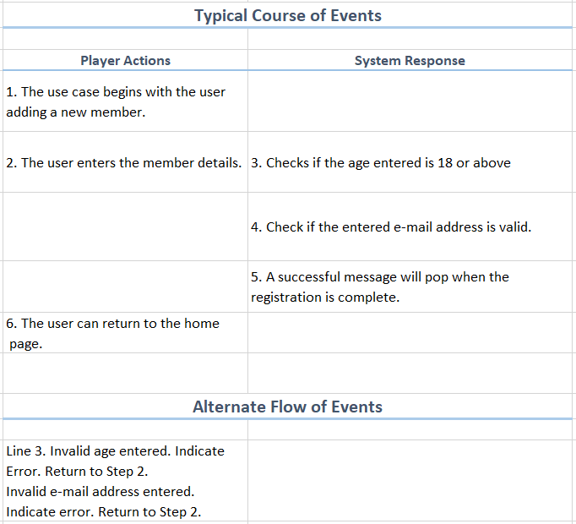
use case diagram to expanded use case
The use case diagram provided a clear visual flow but was unable to describe some steps in more detail.
If more features were to be added, the diagram becomes more cluttered and will only get bigger.
Thus, expanded use cases were created to obtain an in-depth knowledge of these functions.

Slide 5
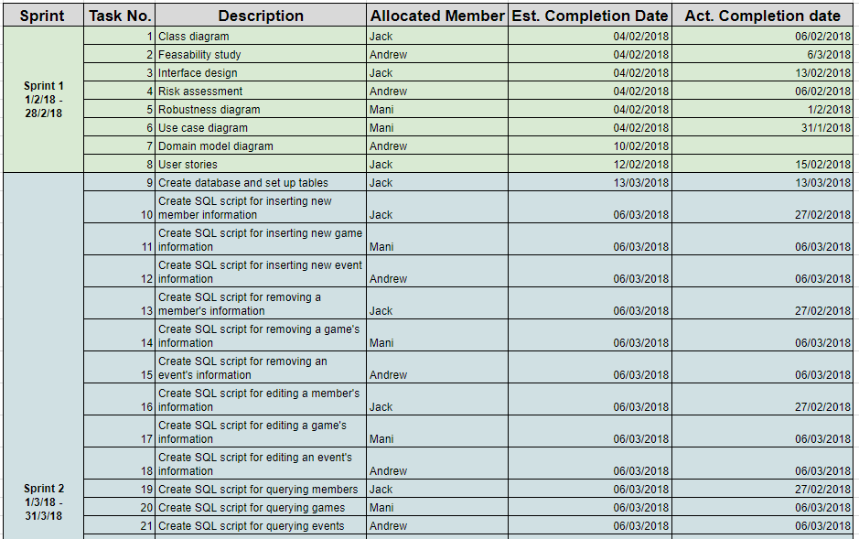
How did it help organise?
The detailed description from the expanded use case helped the team to sort out the weight of the tasks and assign them to each member equally.
The typical course of events enabled the team to understand the flow of processes in more detail and structure the query appropriately.
Notes:
2nd point – The typical course of events [from the expanded use case] enabled

Slide 6
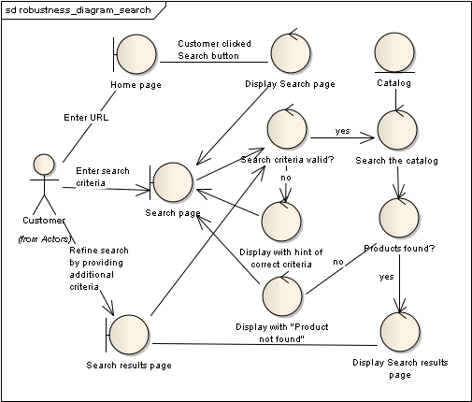
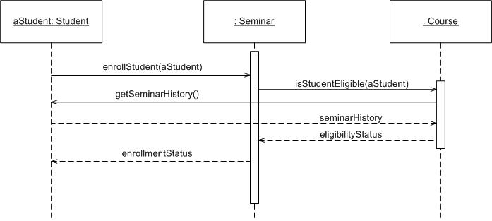
What else can be done?
Other methods to design user interaction with the system are creating Robustness Diagrams and Sequence Diagrams.
Robustness diagrams are the simplified versions of UML class diagrams where each element has a specific purpose/action.
Sequence Diagrams display object interactions and sequence of messages exchanged between the user and the system.

Slide 7
Why were expanded use cases used?
The alternatives shown provide a useful visual flow but is still unable to explain each step in more detail.
Expanded Use Cases combines each diagram’s purpose into one single document.
It is very easy to implement and time-efficient.
Notes:
2nd Point – For example, the typical course of events seen in the expanded use case is what the sequence diagram showcases.
3rd point – I, personally, think it would take less time in writing expanded use cases than drawing a robustness diagram because the diagram had special figures and having them properly placed and aligned was a lot of work. Expanded Use cases where it’s primary textual eased the workload for the team.

Slide 8
References
http://www.comptechdoc.org/independent/uml/begin/umlexusecase.html

